Slide 1
Driving and Movement on Offense
Danielle Montenegro

Slide 2
Movement with a Purpose
As a driver, you need to realize what your purpose for movement is.
As a coach, you need to explain what they are trying to accomplish and what role they play.
Recognize the different options that are created with movement.

Slide 3
Why Drive?
To clear a drop
Post up or establish a new center
To unbalance or rebalance the offense
ALWAYS- to create a scoring opportunity and to move defenders

Slide 4
CLEARING A DROP

Slide 5
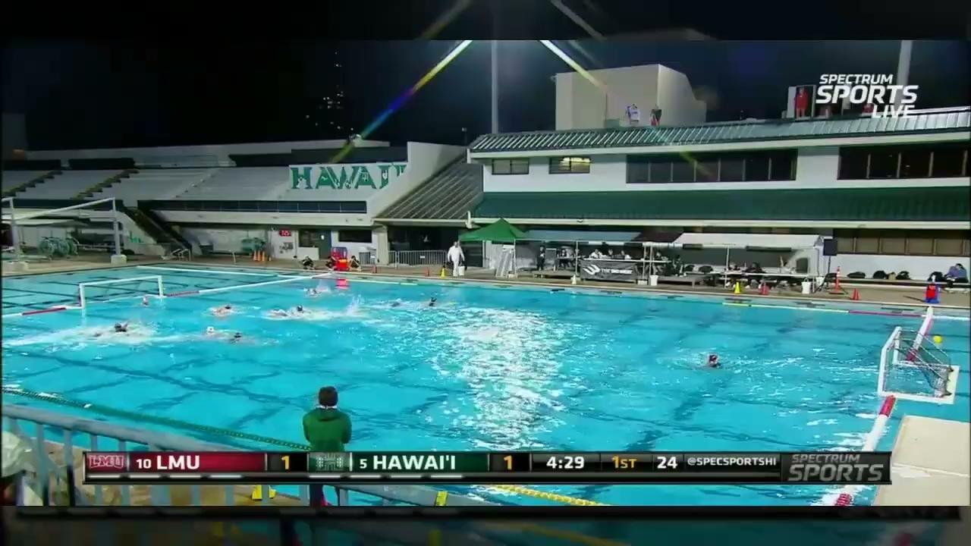
Skills to teach

Slide 6
Clear a Drop
Skills:
Stop and Go - Acceleration in 2-3 strokes and reset legs
Catch and shoot during movement
Do:
Be prepared for a pass at any time
Be aggressive in your movements
Don’t:
Stop halfway through your drive
Body up/ create an offensive

Slide 7
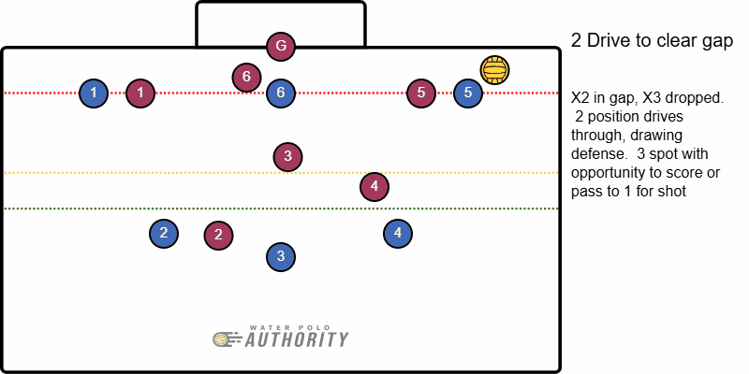
Options
Option 1- Driver as shooter
Option 2- Outside shooter at the 1
Option 3- Outside shooter at the 3 (shifted to 2 post)

Slide 8
Skills to teach

Slide 9
POST UP

Slide 10
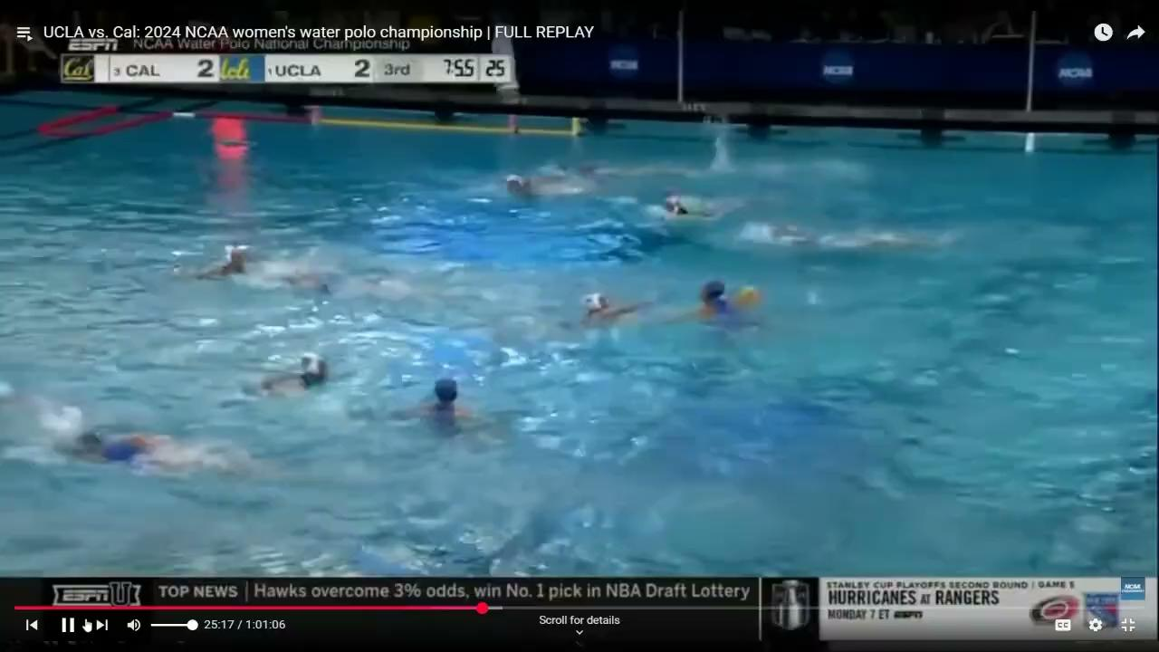

Slide 11
Post Up
Skills:
Making contact
Cross stroke
Hold a side
Opening up for ball
Do:
Create an option for center entry pass on opposite side of the pool
Hold position to allow an entry pass
Don’t:
Go over established center
Crowd established center

Slide 12
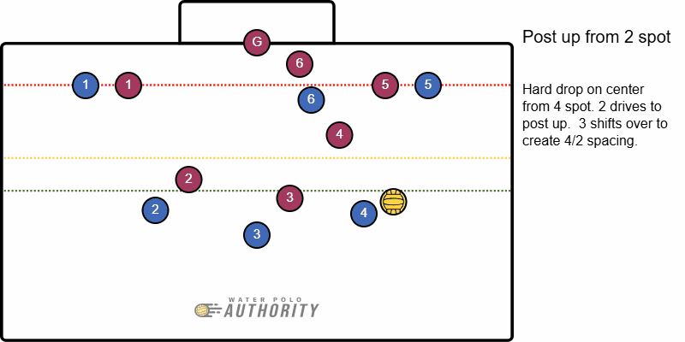
Options
Option 1 - Post up option
Option 2- Outside shooter at 3 position
Option 3- Outside shooter at 1 position

Slide 13
ESTABLISH NEW CENTER

Slide 14
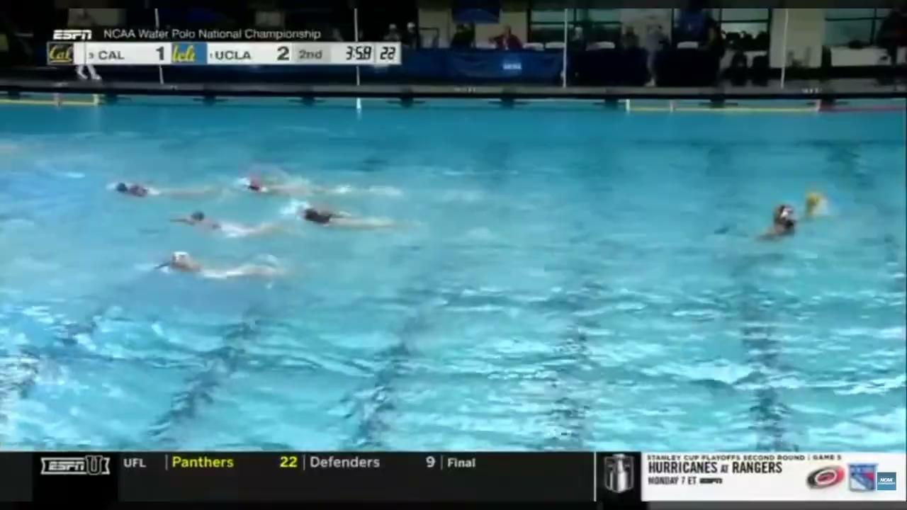

Slide 15
Establish New Center
Skills:
Make contact
Cross stroke
Getting and holding ball side
Opening towards ball
Drawing a foul + kicking ball out if there is a drop
Do:
Get ball side
Hold center of pool position
Don’t
Crowd center

Slide 16
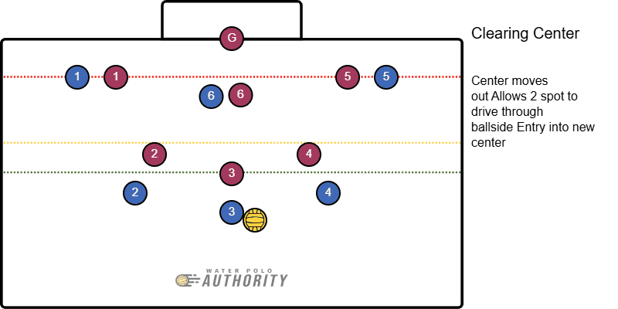
Options
Option 1- Driver as new center
Option 2- If drop from X3 or X4- pop out for outside shot

Slide 17
UNBALANCE THE OFFENSE

Slide 18
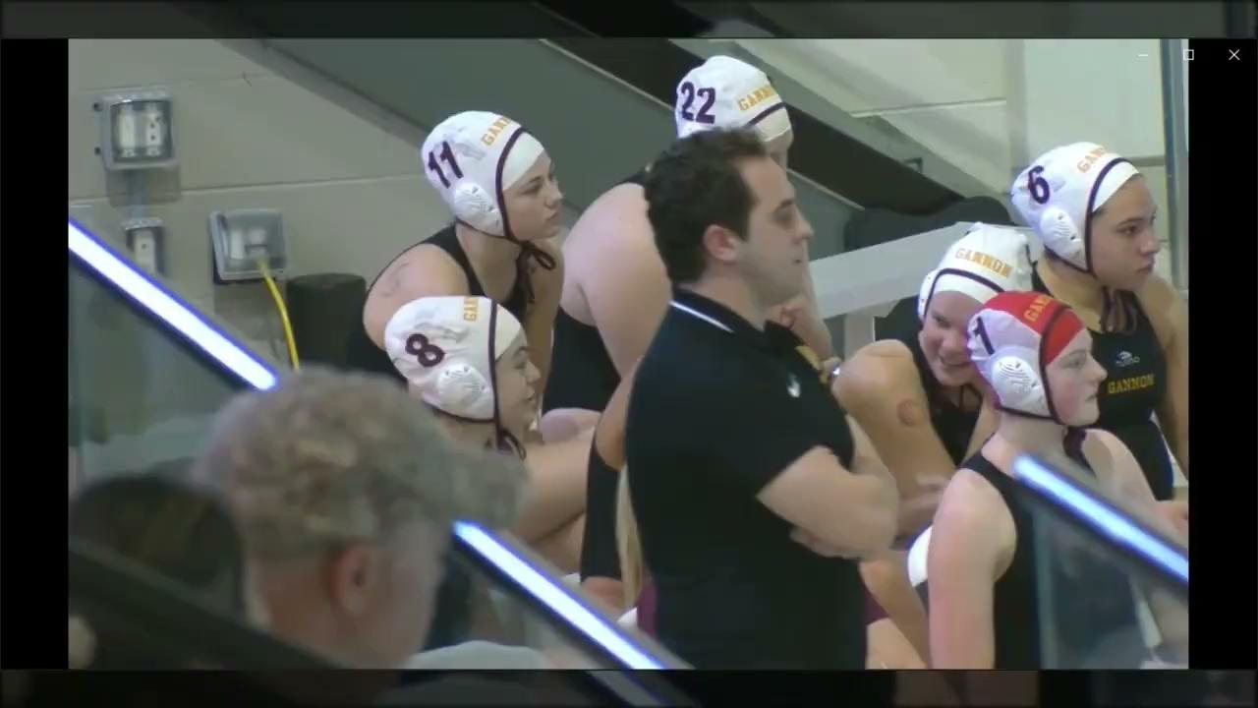

Slide 19
Unbalance the Offense (Isolations)
Skills:
Swimming through traffic
Picks and screens
Do:
Clear the defender
Maintain spacing on opposite side
Don’t:
Tangle Up

Slide 20
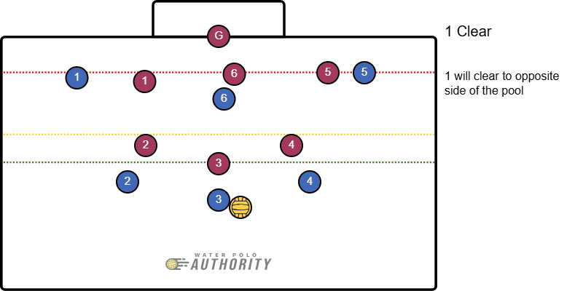
Options
Option 1 - Driver as they clear
Option 2 - Center on isolation side (most likely option)

Slide 21
REBALANCE THE OFFENSE

Slide 23
Rebalance the Offense
Skills:
Reverse sculling
Swim and pivot hips
Do:
Wrap up quickly
Keep yourself in a position to receive the ball
Don’t:
Let defender get the advantage on a counter attack
Ruin an isolation

Slide 24
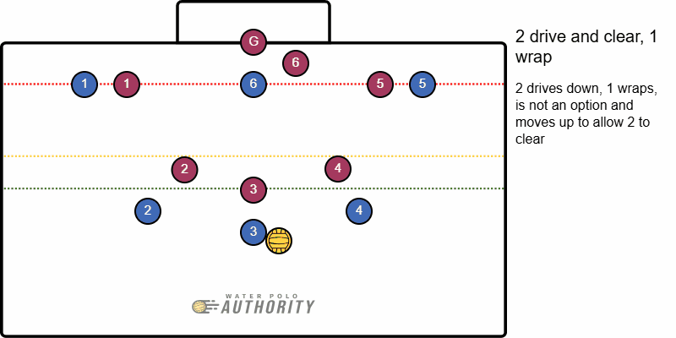
Options
Option 1- pass to 1 as they wrap for shot
Option 2- pass to center as 2 clears out
Drill- add a counter attack from X1 to make sure they are wrapping

Slide 25
General rules
If there is a center:
Drive towards the feet of the center defender
Aggressive strokes to draw the defender
Don’t be over aggressive at the defender
Know your role
Always be an option
Keep the offense balanced

